Slide 1
Free Trade: Challenge, Myths, and Reality
16 March 2017
Free Market Road Show – Prague
John Chisholm, San Francisco, CA

Slide 2
The Key Challenge:
Beneficiaries of free trade are broad, long-term, but diffuse
Beneficiaries of trade barriers are readily identifiable, immediate (but often short-lived), and vocal
So we need to make the benefits of free trade as specific and tangible as possible

Slide 3
Myth: Exports are good. Imports are bad.
Rationale:
Exports mean we are producing, creating local jobs and income.
Imports mean we are consuming, and creating jobs elsewhere.

Slide 4
Myth: Exports are good. Imports are bad.
Reality:
Imports increase our choices, saving us money, improving quality, or both.
Saved money can be spent on other goods or invested.
Notes:
Exports are the price paid to enjoy the imports consumed.

Slide 5
Myth: Exports are good. Imports are bad.
Bottom line:
Both are necessary for prosperity.
Exports are the price paid to enjoy the imports consumed.
Arguably, imports are more important -- exports are just one means to the end of enjoying imports.
Notes:
Both are necessary for prosperity.
Exports are the price paid
to enjoy the imports consumed.
Both are good.
Exports are the price paid
to enjoy the imports consumed.

Slide 6
Myth: Trade barriers protect industries.
Rationale:
If consumers can buy cheaper (or better) goods overseas from countries where wages are lower, they will put local industries out of business.

Slide 7
Myth: Trade barriers protect industries.
Reality:
Few industries, if any, can rely only on inputs from a single country.
Imported inputs reduce production costs and makes industries more competitive.
Notes:
Over half of US imports are production inputs rather than end-user products.

Slide 8
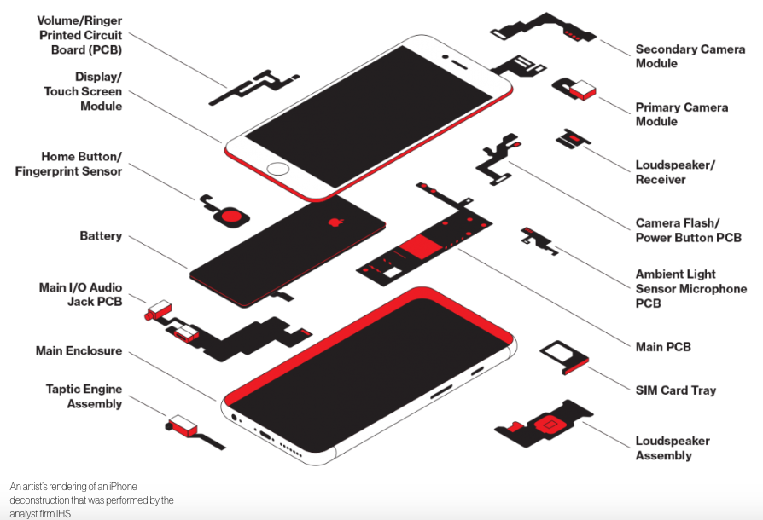
Myth: Making the iPhone in the US would significantly increase US employment.
“The All-American iPhone”, Technology Review, June 9, 2016

Slide 9
Where is the iPhone made?

Slide 10
iPhone Supply Chain
Apple has suppliers in 28 countries, most of them in China, Japan, the US, and Taiwan
iPhone final assembly is a small fraction of the 1.6 million workers in the Apple supply chain
So moving final assembly to the US would have little impact on employment

Slide 11
Estimated Price of an “iPhone” if Sourced and Assembled in the US

Slide 12
An iPhone contains about 75 Elements
– 2/3 of the Periodic Table –
Including ones Not Mined in the US
Red = Element used in the iPhone
“…no tech product from mine to assembly can ever be made in one country,”
says David Abraham, author of The Elements of Power.

Slide 13
Myth: Imports reduce GDP/capita and thus Quality of Life.
Rationale:

Slide 14
Myth: Imports reduce GDP/capita and thus Quality of Life.
Reality:
Imports reduce GDP but also costs of goods, making goods more affordable, increasing consumption and thus GDP
Measuring GDP is problematic
As metrics, GDP/capita and Quality of Life are diverging.

Slide 15
GDP does not Accurately Reflect Intangible/Embedded Imports & Exports
France imports an iPhone from China
Counts as $350 of import from China
But it should be:
$200 import from US (design and software)
Plus $150 import from China (hardware, packaging)
$200 export by US does not show up in US GDP
US Imports iPhone from China
Shows up as $350 import to US which reduces GDP
When consumed, adds $350 to US GDP
Net impact on US on GDP is zero
Again, $200 in US design and software not reflected

Slide 16
Many Improvements in the Quality of Life Reduce (or Don’t Affect) GDP/capita
 | Before | Today & Future
Relationships and Collaboration | Costly physical travel to friends, family, and colleagues Expensive long-dist phone calls | Low-cost real-time video interaction with friends, family, and colleagues
Entertainment | Hire babysitter, drive to theatre, park, buy tickets, snacks Pay usage fees for studio-produced films | Download one movie from NetFlix for entire family 10,000x more choices on free YouTube than from Hollywood
Education | $50K+/year for tuition, dorm, meals, and books for residential campus higher degree | Khan Academy, MITx, eDx, other free online education services School choice movement
Health care | Travel to your physician Expensive clinical trials Pricey proprietary pharmaceuticals | IBM productizing Watson technology to replace physician diagnostics Patients Like Me 3D print open-source pharmaceuticals
Transportation | Airlines, railroads, bus companies, taxi cabs, rental cars | Shared vehicles – Getaround Self-propelled vehicles a la Google

Slide 17
Myth: Buying Food Grown Locally Reduces CO₂ Emissions; Saves the Planet
Reality:
Efficiencies of Climate and Growing Season far Outweigh Eliminating Transportation in CO₂ Emissions

Slide 18
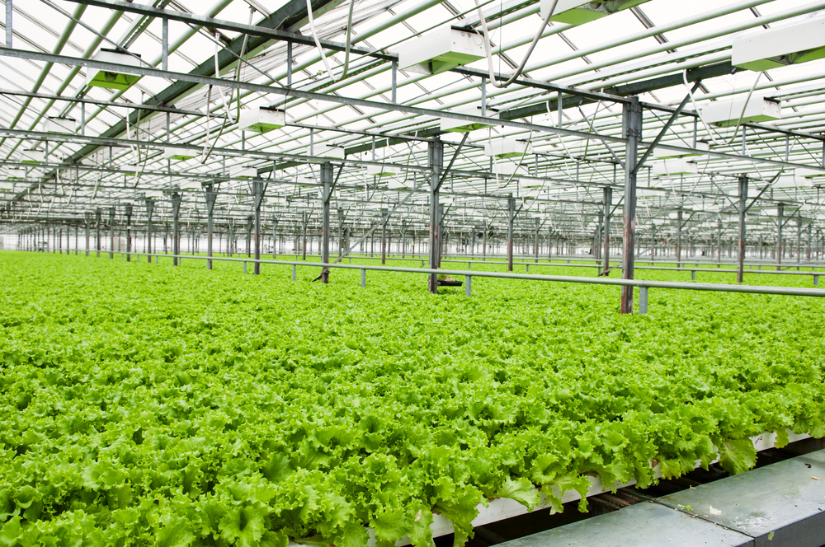
vs.
+
Production = 83%; Transportation = 11% of Food Production CO₂ Emissions

Slide 19
FreeToChoose Network’s Johan Norberg: “Food Miles”
Better to Grow Apples in New Zealand and Ship them to the UK than to Produce them Locally

Slide 20
Myth: Trade barriers enable national sovereignty.
Reality:
The higher and more widespread the barriers, the greater..
Economic uncertainty from changing the barriers either way
Advantage imparted to those best connected and with the deepest pockets who can exploit/influence/reverse trade loopholes/interpretations

Slide 21
Reality: Trade barriers empower governments at the expense of individuals. .
Individuals
Government

Slide 23
Trade
Barriers
Notes:
When we criticize or complain, endorphins flow to our brains and for five seconds we enjoy a sense of well-being. But after that, the endorphins fade away, we lose the sense of well-being, and the ones around us that we criticized are demoralized. This can only be bad.
Many other approaches are better. Asking questions. Articulating consequences. Celebrating the good. Try these instead.

Slide 24
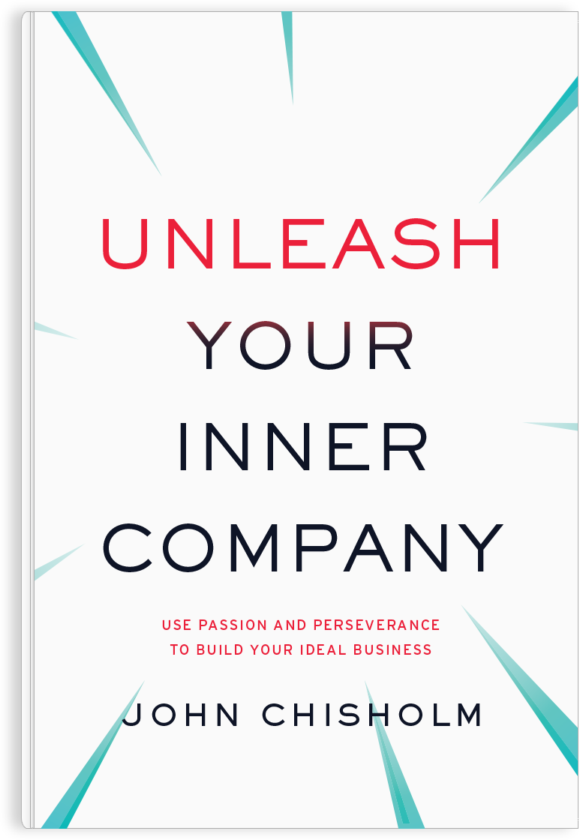
D E K U J I !
John@JohnChisholmVentures.com
www.johnchisholmventures.com
www.unleashyourinnercompany.com
Twitter @johndchisholm
Notes:
When we criticize or complain, endorphins flow to our brains and for five seconds we enjoy a sense of well-being. But after that, the endorphins fade away, we lose the sense of well-being, and the ones around us that we criticized are demoralized. This can only be bad.
Many other approaches are better. Asking questions. Articulating consequences. Celebrating the good. Try these instead.

